Slide 1
Judaism 101
Lynda Ben-Menashe
Education Manager
NSW Jewish Board of Deputies

Slide 2
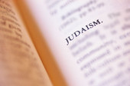
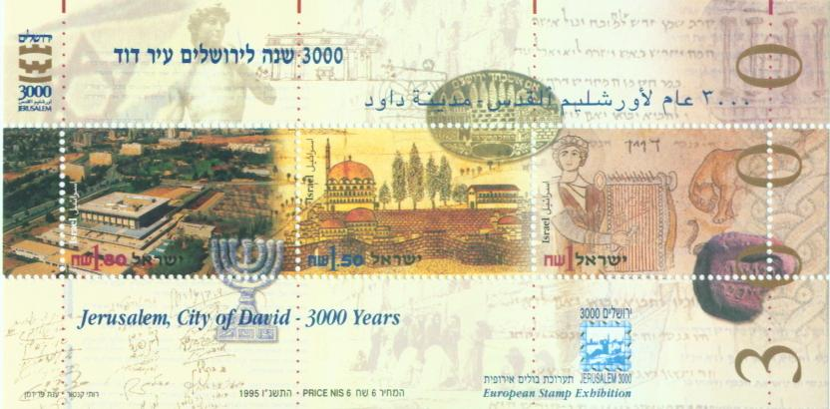
Judaism in the world
The first monotheistic religion
Began c. 4,000 years ago with Abraham
Israel and Jerusalem its spiritual home
0.22% of world population
Jews came to Australia with the First Fleet.
Today 0.5% of Australia’s population.
Notes:
New and appealing faith as there was no human sacrifice.
Jews kept their beards (Torah law) show them as distinct from other religions.

Slide 3
Judaism in the world
Census dates are not always accurate as many Holocaust survivors and their children will not contribute their names to the list for fear of future persecution.
The ramifications of lists used to locate Jews in the Second World War has led to a negative stigma (globally)to be associated with lists such as those created in the census

Slide 4
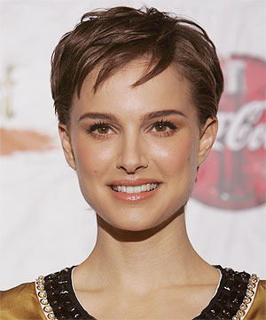
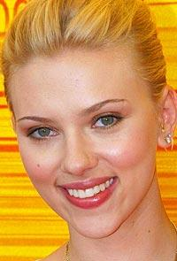
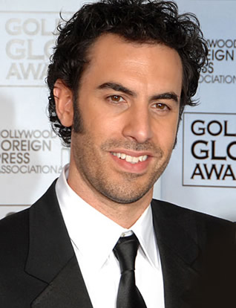
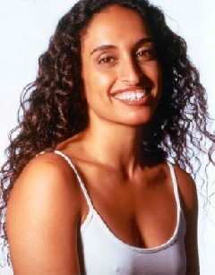
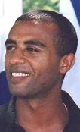
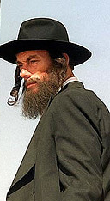
Who are the Jewish people?
The Jewish people are not a race – see above.
The Jewish people share a religious culture and almost 4,000 years of history, beginning with Abraham.
Judaism is based on belief in a single God without shape or form, who is the creator of the universe and who gave human beings moral laws and freedom of choice.
Notes:
Diaspora to Russia – due to the rape of Jews by the Russian Cossacks/Kozaks during this time the appearance of the Jewish people changed to include blonde hair and blue eyes; they are referred to as the Ashkenazi.

Slide 5
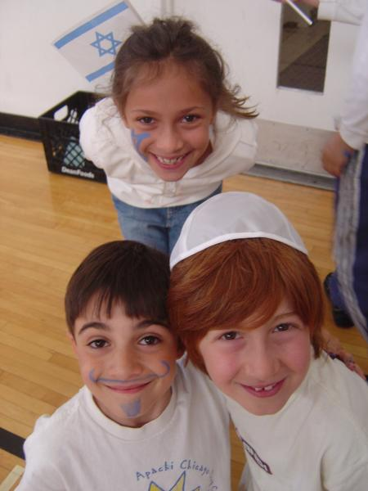
Jewish identities
People may identify as
Jewish by virtue of their
connection to one or many
Of the following:
Faith
Culture and/or Tradition
Birth
Peoplehood- sense of belonging to a people
Israel (over 90% identify as ‘Zionists’)
Jewish History
Notes:
Zionists: is a Jewish political movement that, in its broadest sense, has supported the self-determination of the Jewish people in striving for a sovereign Jewish national homeland.[

Slide 6
Israel
Israel = he who struggles with God
Jacob the son of Isaac changes his name to Israel
Genesis 32:28
"Then the man said, 'Your name will no longer be Jacob, but Israel, because you have struggled with God and with men and have overcome."

Slide 7
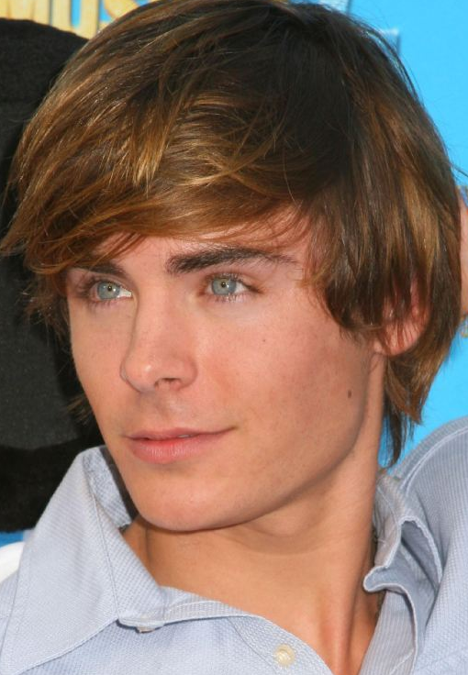
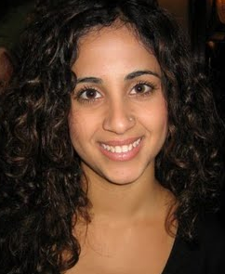
Jewish ethnic groups
Ashkenazi (‘Ashkenaz’ = Germany)
Mizrachi (‘Mizrach’ = East)
Sephardi (‘Sepharad’ = Spain)

Slide 8
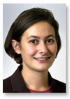
Who are the Jewish people?

Slide 9
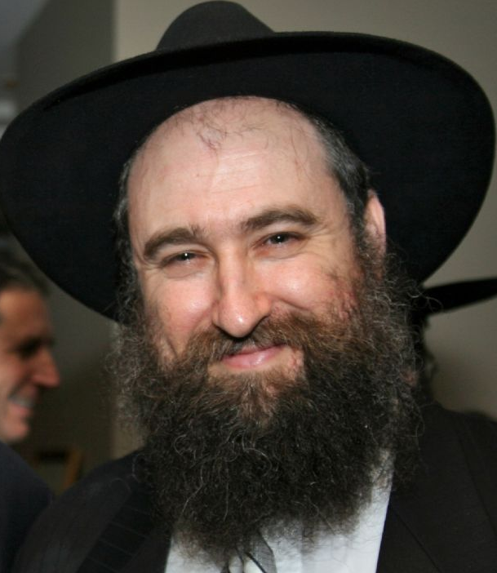
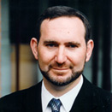
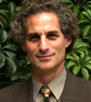
Streams of Judaism in Australia
Ultra-Orthodox (Hassidim) <10%
Modern Orthodox 5%
‘Traditional’ 75% (Orthodox synagogues)
Conservative +
Progressive/Reform 10%

Slide 10
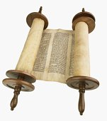
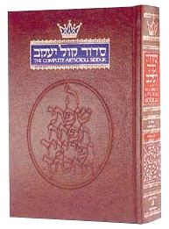
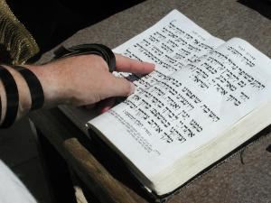
Sacred Jewish Texts
TANACH =
Torah (5 books Moses) + Neviim (Prophets) + Ketuvim (Writings)
Talmud = oral law + commentaries + ‘Ethics of the Fathers’
Midrash = interpretations of Bible stories
Halacha = Jewish law
Siddur = prayerbook (‘order’ of prayers)

Slide 11
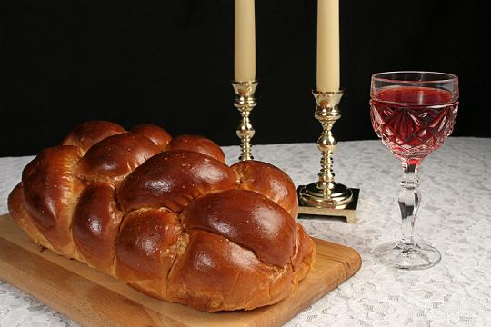
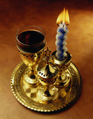
Jewish Life: Shabbat
“And on the seventh day He rested”
A day of rest, reflection & appreciation
‘A window in time’: 25 hours of family togetherness at home & synagogue
As on the seventh day, no creation or destruction: no working, no driving, no electricity, no cooking…
‘Havdalah’ at the end
Notes:
There are 39 categories of work allowed on the Sabbath, derived from the types of work performed during the creation of the Temple.
25 Hour Sabbath – the extra hour is likened to the extra barrier/fence around the Temple to allow any discrepancies which will be remedied by the one hour buffer.

Slide 12
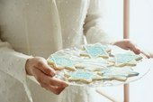
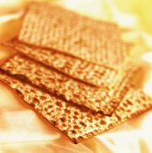
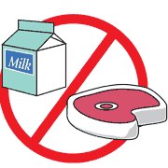
Jewish Life: Kosher food
Like vegetarianism and other religions’ dietary systems, kashrut is a philosophical approach to eating. ‘Kashrut’ (‘proper or fit’) is the name for Jewish dietary law.
Basic rules: Separation of meat and milk; kosher animals, fish and birds; humane slaughter of meat (‘shechita’); supervision

Slide 13
Jewish Life: Reasons to support Kosher food
POLITICAL – separates the Jewish people from other ideas.
HEALTH – the benefits of not mixing certain foods or eating types foods that may be harmful.
PHILOSOPHICAL – ‘you are what you eat’ cattle are seen as passive animals as opposed to lions and tigers which are not to be consumed.
DISCIPLINARY– following instruction from God.
SCIENTIFIC – adhering to food chains and how they support the ecosystem e.g. not consuming birds of prey.

Slide 14
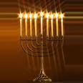
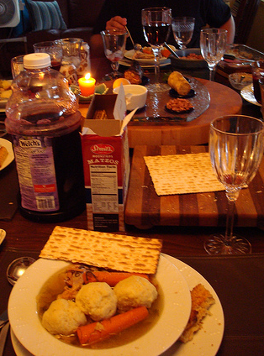
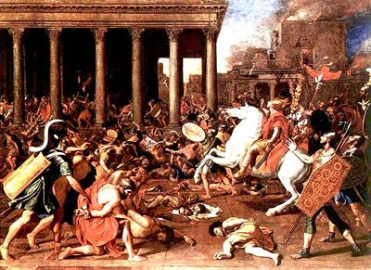
Jewish Life: Festivals & Fasts
The Jewish calendar
Chanukah, Passover (Pesach)
Rosh Hashanah
Yom Kippur
Tisha B’Av
Notes:
The year 2011 equates to the Jewish lunar year 5771

Slide 15
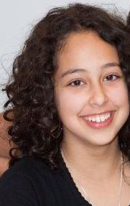
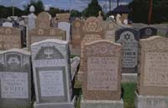
Jewish Lifecycle
Birth: Brit Milah for boys, Simchat Bat for girls
Bar/Bat Mitzvah: taking on all the adult responsibilities towards community and God, reading from the Torah or speaking about it in public
Marriage: Sanctification – 3 in the marriage, Chuppah and customs
Death: Respect for the dead, burial etc. Stages of mourning: shiva (7 days) shloshim (30 days) yahrzeit (1 year)
Notes:
Bethdin – House of the Jewish Court

Slide 16
Jewish Lifecycle: The Afterlife
Believe that any good person goes to heaven
No concept of hell
Gehennom – similar to the Catholic concept of purgatory
Heaven as a place of lights and unified souls
The soul as an eternal light from a unified source (God)
There are many paths to heaven and God
The body is on loan from God, as a result Jews do not agree with tattoos, cremations and suicide.
A guard stands watch until the body is buried for security purposes as the soul is not released from the body until it is buried. This task is viewed as one of the highest forms of charity.
The Zacar (ultra-orthodox) are a team of men who collect the remains to ensure the whole body is laid to rest.

Slide 17
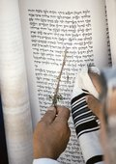
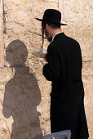
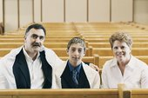
Jewish Life: Prayer & Study
Tefilla (prayer): praise, thanks, requests
Equipment: tallit, tefillin, siddur
Synagogue services
Study and prayer
Women and prayer

Slide 18
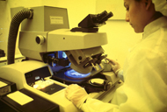
Jewish Life: Ethics
The basic principle of Tikkun Olam
‘Healing the World’
Environmental ethics
Bioethics
Social ethics
Tzedaka

Slide 19
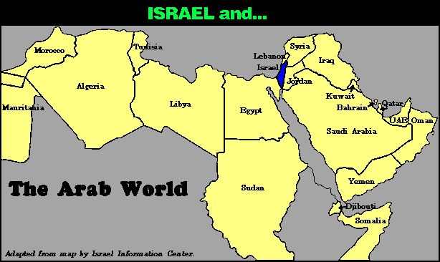
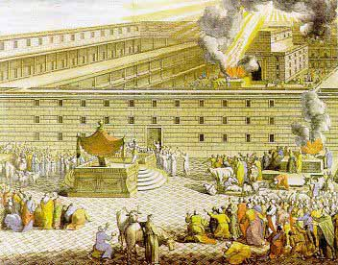
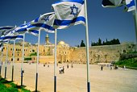
Israel - the Jewish homeland
Historical Jewish presence in the land of Israel
Zionism – the yearning to return home
Re-establishment of State of Israel 1948
Ingathering of the exiles

Slide 20
Israel today…

Slide 21
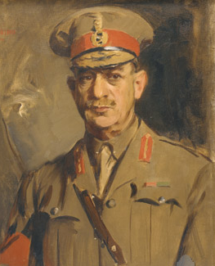
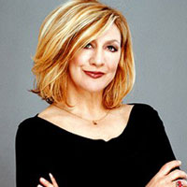
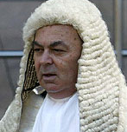
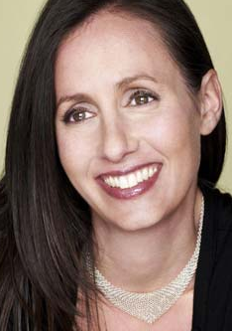
Some famous Jewish Australians
2 governors-general: Sir Isaac Isaacs, Sir Zelman Cowan
General Sir John Monash
Judges: NSW Chief Justice Jim Spiegelman; Aaron Levine, David Levine, Sydney Einfeld and others
Fashion designers: Josh Goot, Trent Nathan, Natalie Bloom
Arists: David Helfgott, Ben Lee, Renee Geyer, Judy Cassab, Diane Armstrong

Slide 22
Other Jewish People FYI

Slide 23
Commonalities: Judaism & Christianity
Hebrew Bible (Torah) = The Old Testament
Same God
Same 10 Commandments
Jesus was a Jew who lived a Jewish life
Main principle is “Love thy neighbour as thyself”

Slide 24
Commonalities: Judaism & Islam
Both Abrahamic faiths – Isaac and Ishmael were brothers, and in Hebrew we are called “cousins”
Same prophets up to Moses
Similar dietary laws
Similar laws of modesty and dress
Similar laws against graven images, etc.
Jews pray 3 times a day facing Jerusalem, Muslims 5 times a day facing Mecca

